Slide 1

Review 1 MyPrepPal An AI powered Mock Interview Platform Project Category: PRODUCT
Guide Name Student Name & Registration Number
Dr.C.Sherin Shibi A.SREEDHAR REDDY RA2211026010033
Y.MADHU MOHAN REDDY RA2211026010063

Slide 2
Abstract
MyPrepPal is an AI-powered web application designed to help users excel in interviews. It offers targeted question prompts, real-time feedback on responses, and personalized suggestions for improvement, all within a user-friendly interface featuring collapsible feedback views and session storage for progress tracking. Built with React, Next.js, Node.js, and PostgreSQL, MyPrepPal provides a comprehensive and effective interview preparation experience.

Slide 3
Introduction
MyPrepPal is an AI-driven web application designed to help users prepare for interviews effectively by providing real-time feedback on their responses.
By generating tailored interview questions based on selected topics and difficulty levels, MyPrepPal allows users to practice in a structured manner.
The platform's interactive interface enables users to receive instant feedback, review suggestions for improvement, and track their progress over time.
Built using modern web technologies such as React, Next.js, Tailwind CSS, Node.js, Drizzle ORM, and PostgreSQL, MyPrepPal ensures a seamless and efficient user experience.

Slide 4
Product Vision Statement
MyPrepPal's vision is to revolutionize interview preparation by leveraging AI to deliver personalized question prompts, real-time feedback, and performance ratings.
Our goal is to empower users with the tools they need to excel in interviews, allowing them to engage in unlimited practice sessions that foster continuous improvement and confidence.
Through innovative technology, MyPrepPal aims to create a supportive environment where every user can transform their interview skills and achieve their career aspirations
Note: Note: For further clarity, please refer to the following link.

Slide 5
Product Backlogs Note: For further clarity, please refer to the following link
ID | Title | Epic | User Story | Priority (MoSCoW) | Status | Acceptance Criteria | Functional Requirements | Non-Functional Requirements | Original Estimate | Actual Effort (In days)
1 | User Authentication | User Management | As a user, I want to sign up, log in, and log out securely. | Must Have | To Do | Users can register and log in securely. | Implement authentication with Clerk. | Ensure encryption and security best practices. | 3 days | TBD
2 | Generate Interview Questions | Interview Generation | As a user, I want to receive interview questions based on topic and difficulty level. | Must Have | To Do | Users can select topics and difficulty to generate questions. | Develop question-generation logic. | Ensure question diversity and accuracy. | 5 days | TBD
3 | Real-Time Feedback | AI Feedback Engine | As a user, I want instant feedback on my responses to improve. | Must Have | To Do | Users receive feedback immediately after answering. | Integrate AI-based evaluation and scoring. | Optimize response time to under 2s. | 7 days | TBD
4 | Session Storage & History | Session Management | As a user, I want to review past interview sessions. | Must Have | To Do | Users can access past interview responses and feedback. | Implement session tracking and database storage. | Ensure scalability and performance. | 4 days | TBD
5 | Collapsible Feedback UI | UI/UX Enhancement | As a user, I want a collapsible feedback section for easy navigation. | Should Have | To Do | Feedback section collapses and expands smoothly. | Develop an interactive UI component. | Ensure smooth animation and responsiveness. | 3 days | TBD
6 | Dashboard Overview | UI/UX Enhancement | As a user, I want a dashboard that summarizes my progress. | Should Have | To Do | Users can view key stats and session summaries. | Implement a dashboard with and summaries. | Ensure visual appeal and clarity. | 4 days | TBD
7 | Custom Interview Modes | Personalization | As a user, I want to create custom interview modes with specific questions. | Could Have | To Do | Users can set custom question types and durations. | Develop a mode-selection feature. | Maintain database integrity. | 5 days | TBD
8 | Mobile Compatibility | Cross-Platform Support | As a user, I want a seamless experience on mobile devices. | Could Have | To Do | Application is fully responsive on different devices. | Optimize UI for mobile screens. | Ensure fast loading times. | 6 days | TBD
9 | Admin Panel for Content Management | Admin Features | As an admin, I want to manage questions and feedback. | Could Have | To Do | Admins can add, edit, and delete questions. | Develop an admin interface with CRUD operations. | Ensure role-based access control. | 6 days | TBD
10 | API Documentation | Developer Support | As a developer, I want clear API documentation for integration. | Must Have | To Do | API documentation is available and up-to-date. | Create detailed API endpoints documentation. | Ensure documentation is readable and well-structured. | 3 days | TBD

Slide 6
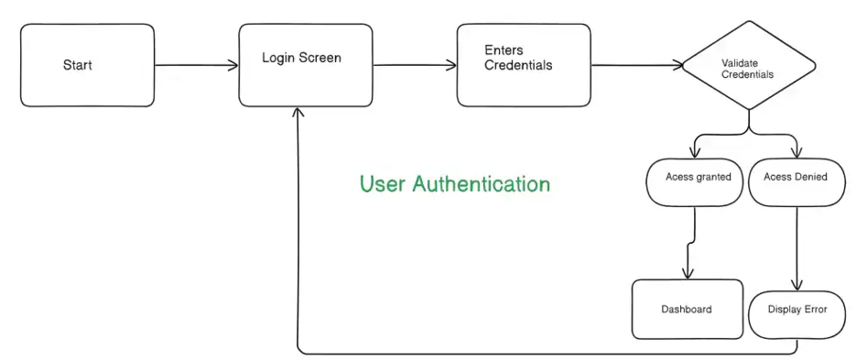
System Architecture based on current user stories

Slide 7
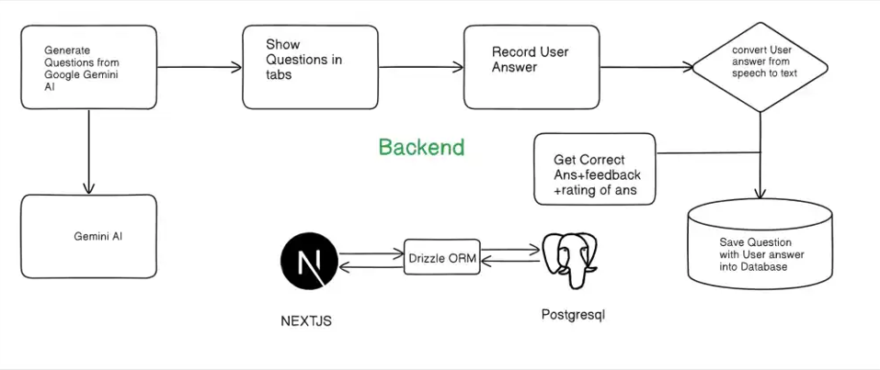

Slide 8
Justification of Project SDG
MyPrepPal aligns with Sustainable Development Goal 4 (Quality Education) by revolutionizing interview preparation through personalized, AI-driven learning experiences.
The platform generates customized interview questions based on user profiles, ensuring relevance and enhancing engagement.
Users receive instant feedback on their responses, helping them identify strengths and areas for improvement, which fosters continuous learning.
MyPrepPal allows users to conduct unlimited mock interviews, promoting mastery of skills and building confidence in a supportive environment.
Designed for job seekers at all levels, MyPrepPal ensures equitable access to quality resources, empowering diverse users to enhance their interview skills.
The platform tracks user progress and provides analytics, enabling informed decisions about preparation strategies.

Slide 9
Product Roadmap/ Release Plan
A release plan for MyPrepPal outlines the strategic approach for launching and enhancing the platform to ensure effective interview preparation. It serves as a roadmap that guides the development, testing, and deployment of features aimed at improving user experience and educational outcomes.
Note: For further clarity, please refer to the following link

Slide 10
References
1. In-Ho Ra, Young-Seok Lee (School of Computer & Software, Kunsan National University, Gunsan, Republic of Korea;Yi-Chi Chou, Felicia R. Wongso, Chun-Yen Chao, Han-Yen Yu (Digital Education Institute, Institute for Information Industry, Taipei, Taiwan(An AI Mock-Interview Platform for Interview Performance Analysis.)
2. Yi-Chi Chou, Felicia R. Wongso, Chun-Yen Chao, Han-Yen Yu (Digital Education Institute, Institute for Information Industry, Taipei, Taiwan; (An AI Mock-Interview Platform for Interview Performance Analysis.)

Slide 11

Thank You

